Slide 1


Programming & STRATEGY Workshop
OHIO KICKOFF EVENT

Slide 2
Introductions

Slide 3
NOT THE DROIDS YOU ARE LOOKING FOR
Nickname: Droids
7th years in FIRST LEGO League
Won Champion’s (1st, 2nd, 3rd) and Robot Performance (1st, 2nd) at States every year
Attended 5 International Tournaments
2014: International Open Toronto – 1st Innovative Solution
2015: International Open Arkansas – 1st Champion’s, 2nd Robot Performance
2016: World Festival – 1st Programming, 6th Robot Performance
2016: Global Innovation Award semi-finalist (top 20 out of 29,000 teams)
2017: World Festival – Coach/Mentor Award (as team coaches)
Fun fact: Founded EV3Lessons.com in 2014 as our FIRST LEGO League project which now has 200,000 users in 175 countries

Slide 4
ROBOT GAME

Slide 5
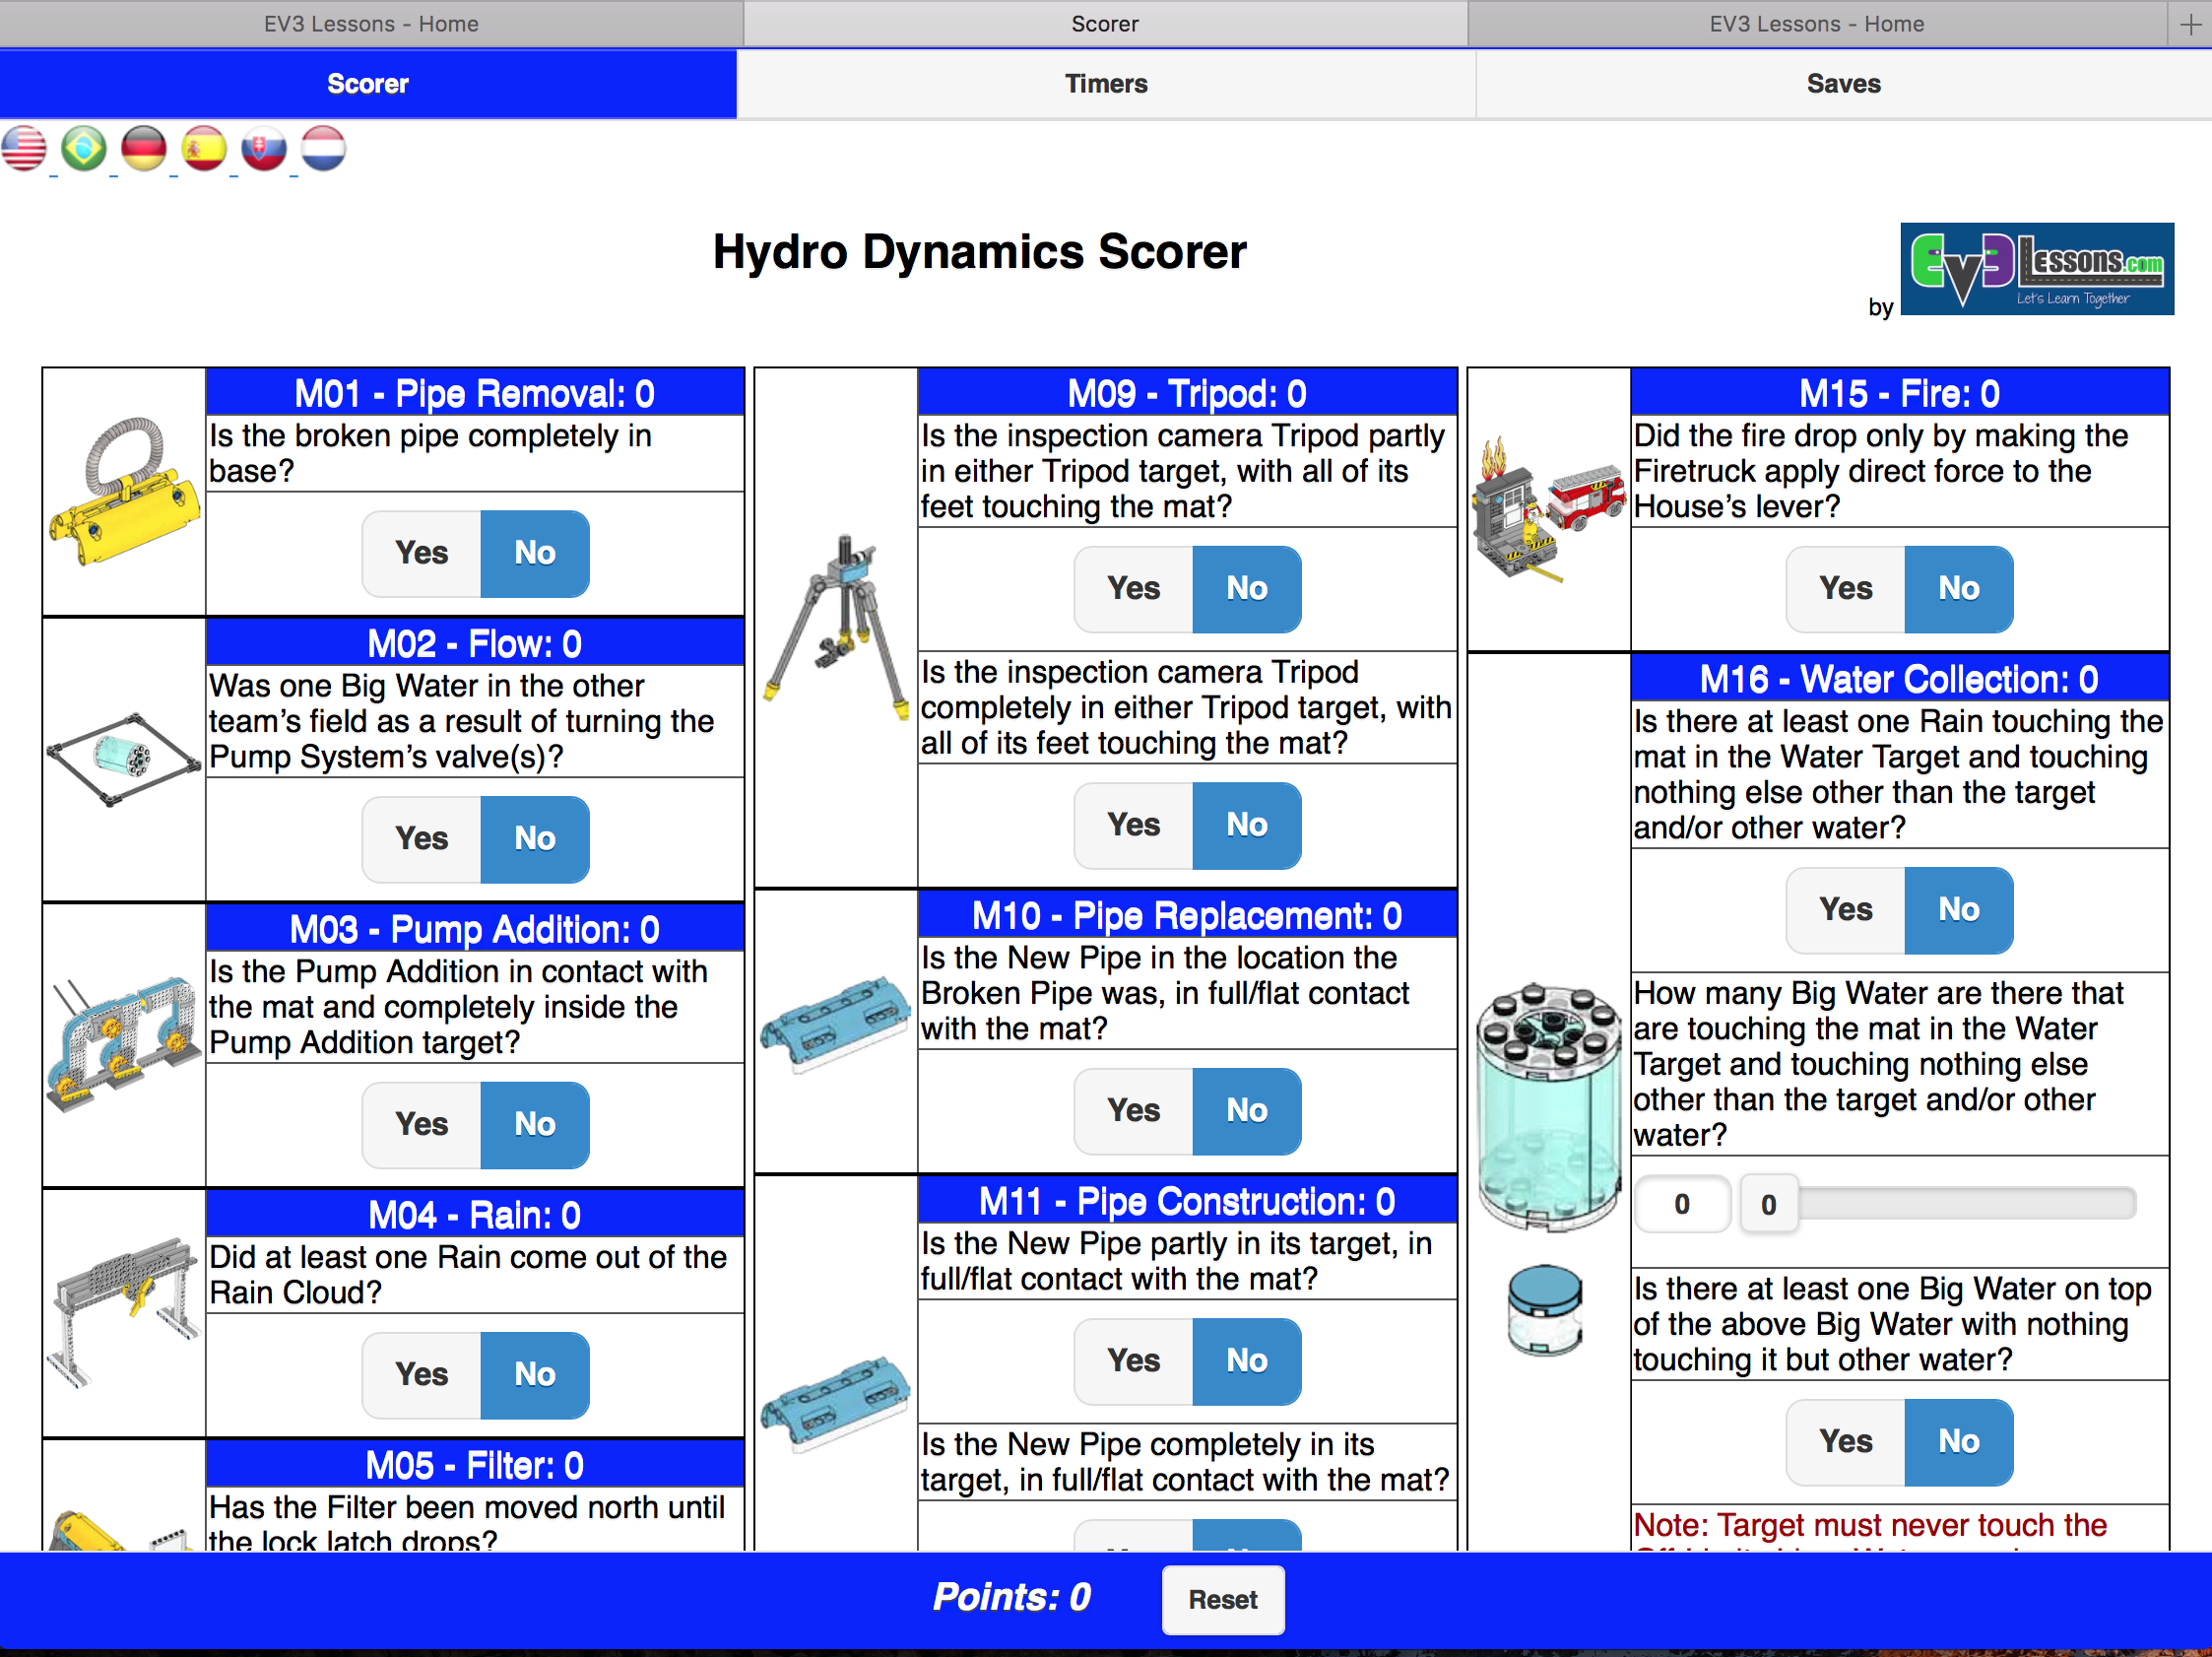
IMPORTANT ASPECTS OF THE GAME
Sample Scorer
Rules changes each year
Get familiar with some of these terms
Height – 12 inches
Junk - none
Straddling Base
Touch Penalties – 5 pts. each
Base rules about in/out – completely in
Mission rules about partially in versus fully in
Transportation
Scoring
Track your own score during the season
http://ev3lessons.com/resources/scorer/

Slide 6
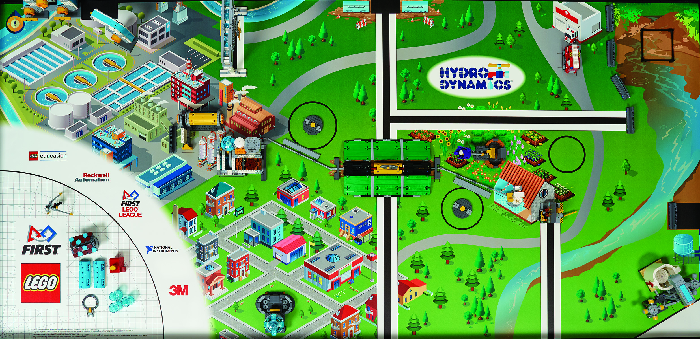
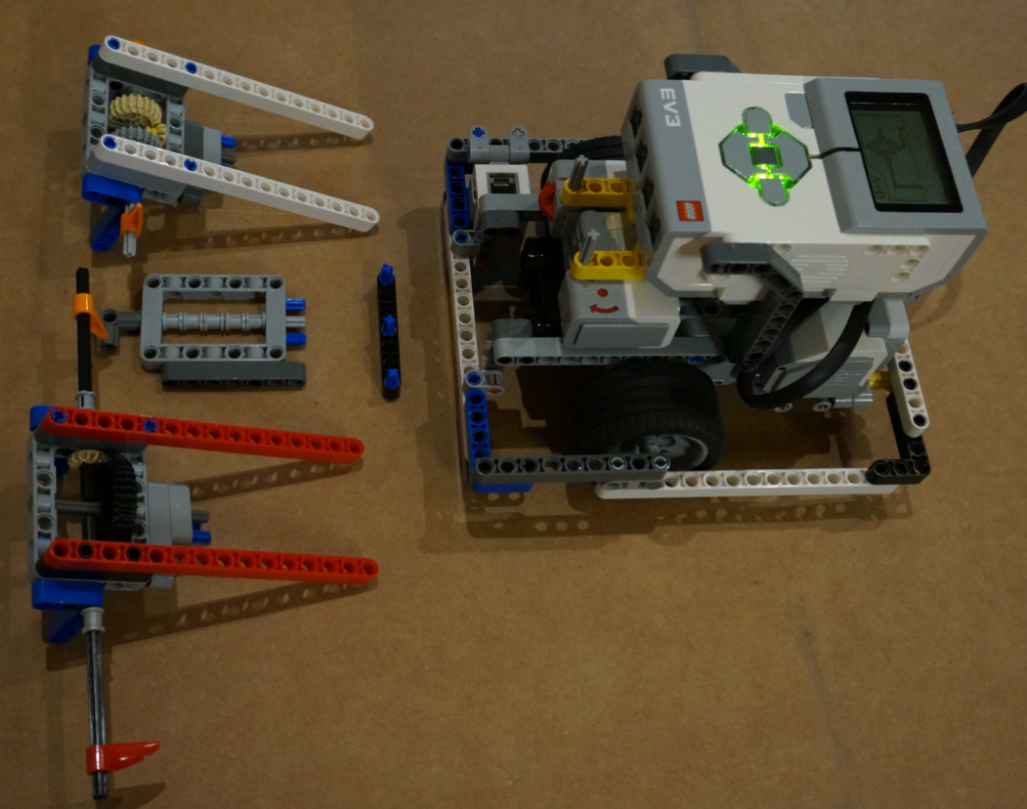
TERMS TO KNOW
A mission is one of the approx.15-18 tasks that the robot must complete on the FIRST LEGO League table.
A Run is every time the robot leaves the base area. During this run, the robot may complete one or more missions.
A base robot is just the main MINDSTORMS robot chassis.
The attachments are other mechanisms added to the base robot to complete a mission (e.g. an arm)

Slide 7
Developing a Mission Strategy

Slide 8
Questions to Ask
Which missions are near base and could be done quickly?
Which missions might be grouped together because of their proximity?
Which missions might use the same attachment/tool to complete?
Are some missions harder than others?
Are some missions harder to get to?
What are the team’s goals for the year when it comes to the robot game?
How many points is the mission?
Use the answers to the questions to determine which missions to do and when.
A Planning Guide is available on the next page.

Slide 9
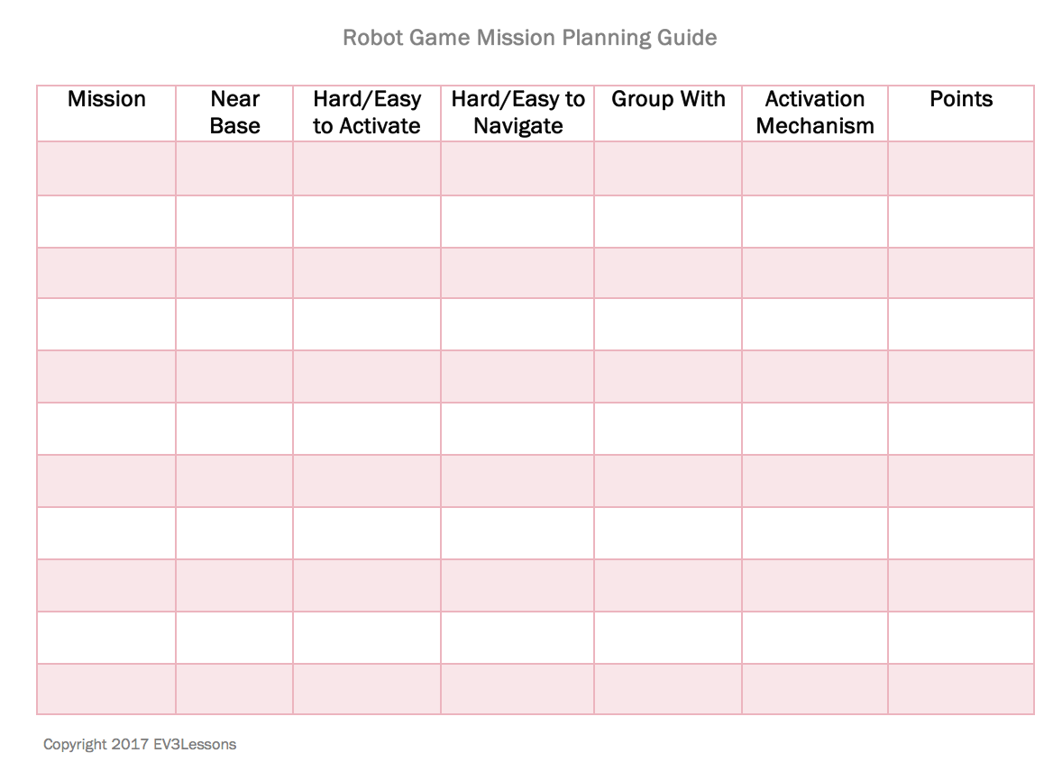
Mission Planning GUIDE
This worksheet is available for download on EV3Lessons
Use it to evaluate all your options for a given year’s robot game

Slide 10
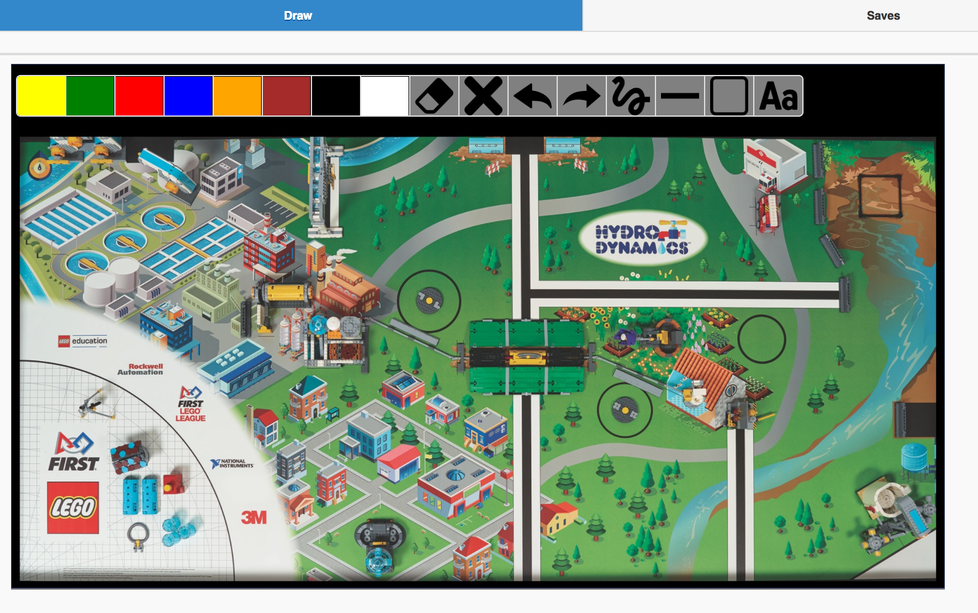
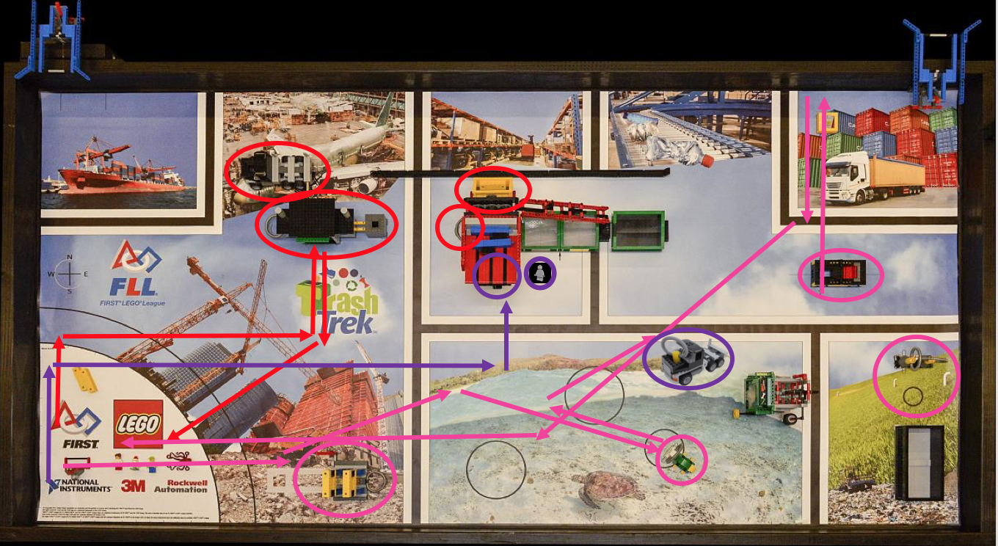
Robot Game Strategy
Use an online tool such as our Interactive Sketch Planner to determine the path your robot will take
Each time you go out of base is called a “run”
Draw each run using a different color.
Or print out an image of the challenge mat and hand-draw
We recommend that each team member comes up with a strategy and then the team listens to all the ideas and combines them.
http://ev3lessons.com/resources/

Slide 11
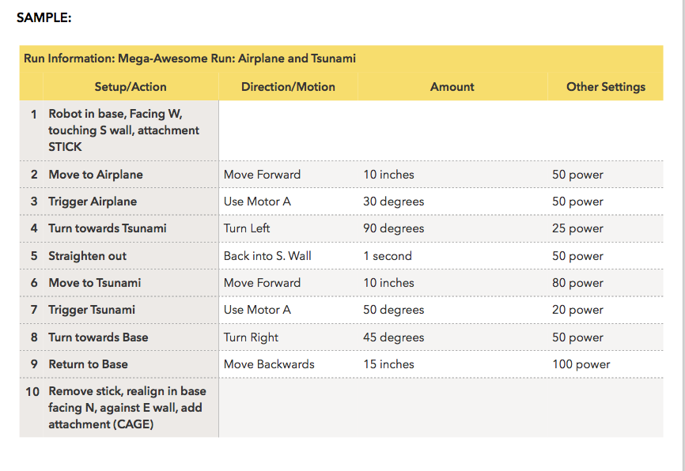
Now What?
Once you have a strategy, start to build your robot and write Pseudocode for each “run”.
This worksheet is provided on EV3Lessons
We have an additional Pseudocode lesson in Beginner if you want to learn more about how to write pseudocode.

Slide 12
Some Thoughts
Remember that a robot game strategy may change over time
You might get a new idea or find a way to combine missions
You might build a different attachment
As a rookie team, complete missions closer to base first
Usually, they are easier to get to and easier to activate
When you finish those and can do them reliably, start to add more missions
You don’t need to do all the missions to “win”.
Doing the missions you can well can often yield better results than completing all the mission unreliably.
Example: We have won the robot performance award and Champion’s without completing all the missions

Slide 13
BUILDING A ROBOT

Slide 14
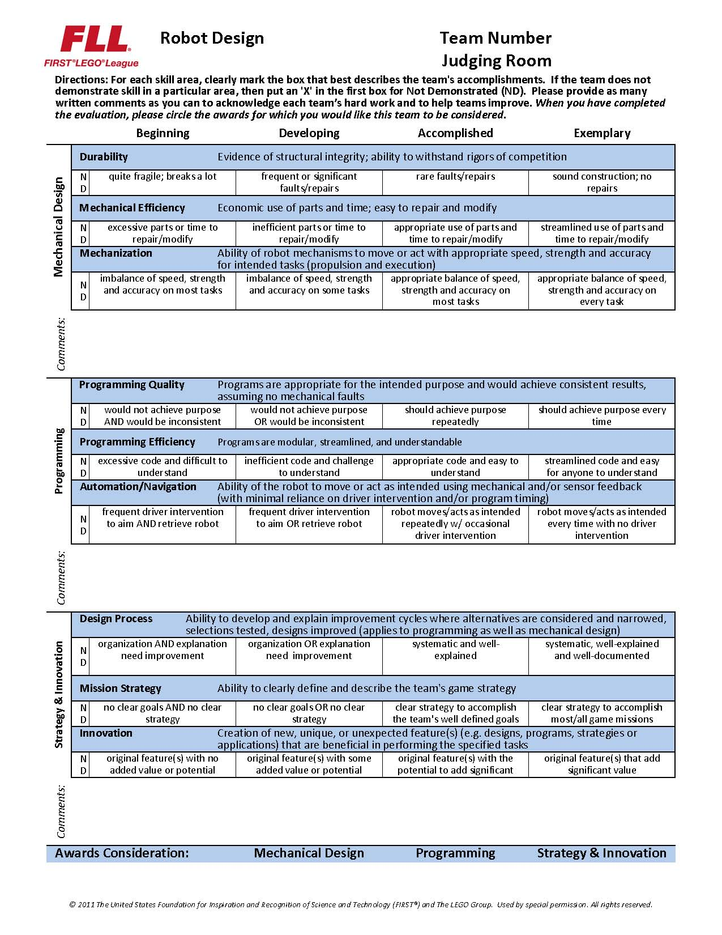
Start with the ROBOT DESIGN RUBRIC
Mechanical Design:
Durable, efficient, and capable of executing tasks
Programming:
Clear and concise code that allows the robot to be autonomous and consistent
Strategy & Innovation
Clever robot designs and programming and well developed strategy

Slide 15
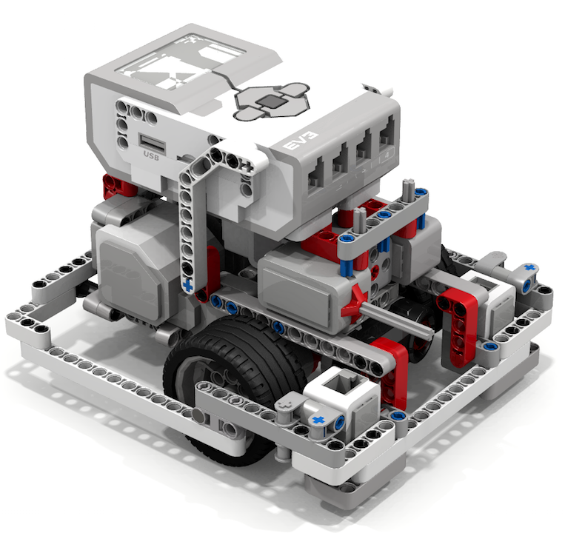
ROBOT DESIGN TIPS
Sturdy, well-balanced
DroidBot is made with one EV3 Core Set (+ optional extra color)
Recommended by FIRST Steps (curriculum written by FIRST)
Link for FIRST Steps http://info.firstinspires.org/fllfirststepsrequest
Can download design from EV3Lessons
Consider adding these features basic to your robot
Access to charging port and USB port
2 color sensors to align
Compact
Outer wall to align and keep wheels in place

Slide 16
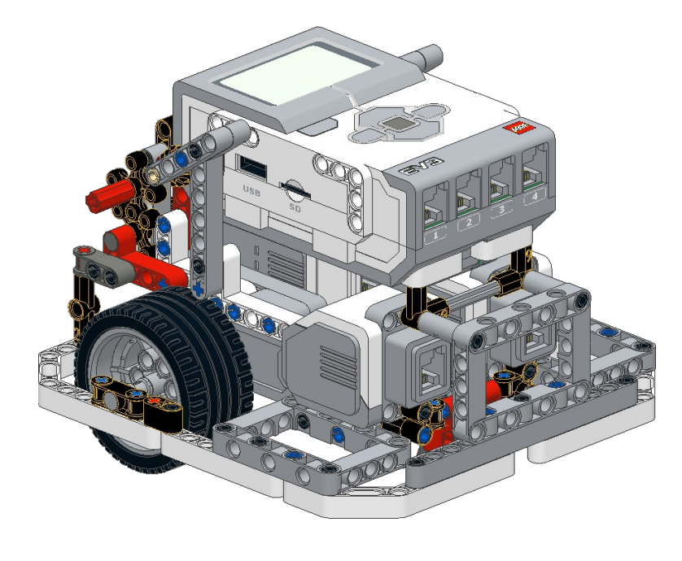
ROBOT DESIGN TIPS
Sturdy, well-balanced
COR3 is an alternative design on EV3Lessons made with one EV3 Core Set
Consider adding these features basic to your robot
Easy access to battery
Compact
Outer wall to align and keep wheels in place
Attachment possibilities

Slide 17
Reliability

Slide 18
HOW CAN YOU INCREASE RELIABILITY?
Consistent aligning in base
Frequent aligning during a run

Slide 19
Starting Points in Base are Critical
Mission
In FIRST LEGO League, teams need to figure out where to start in base
Jigs: a LEGO ruler/wall that your robot can align against them in base
Same start each time: pick one spot and start there no matter what the mission for easy starts
Marks/Radial lines: Use the marks to pick a starting spot for each run
Words: Base has words. If you aren’t near an inch mark, pick a word or letter to start on.
Use a jig
Use marks

Slide 20
Errors Accumulate Over Time
By the time you get to the far side of the table, you are no longer in the right position
Solution: Repeat alignment techniques multiple times in a run for better reliability (see next slide)
Mission Model 1
Mission Model 2

Slide 21
Where Are You on the FLL table?
Consider these alignment strategies that are commonly used:
Move until a sensor reading– E.g., travel until you find a line so you know where you are on the mat (See Beginner: Color, Ultrasonic and Touch Sensors)
Align on walls/mission models – deliberately back into a wall/model to straighten out (note: You may stall doing this – Tip: use move seconds or a touch sensor)
Square/Align on lines –If you are moving angled, you can straighten out whenever you see a line. (See Advanced: Squaring Lesson)
Back into walls
Square on a line
Align on a mission model
Mission Model

Slide 22
PROGRAMMING

Slide 23
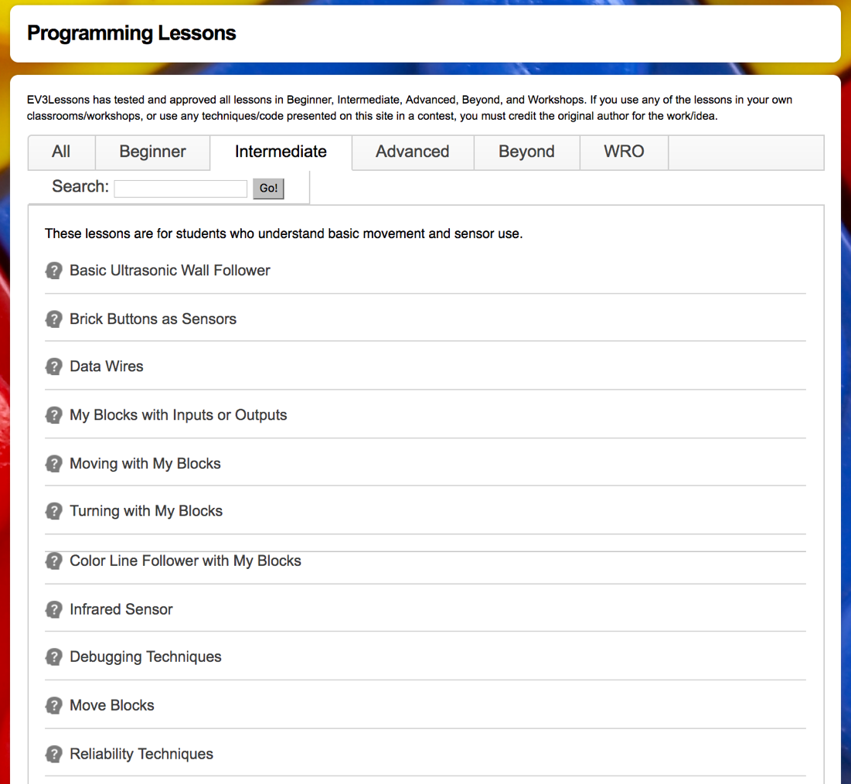
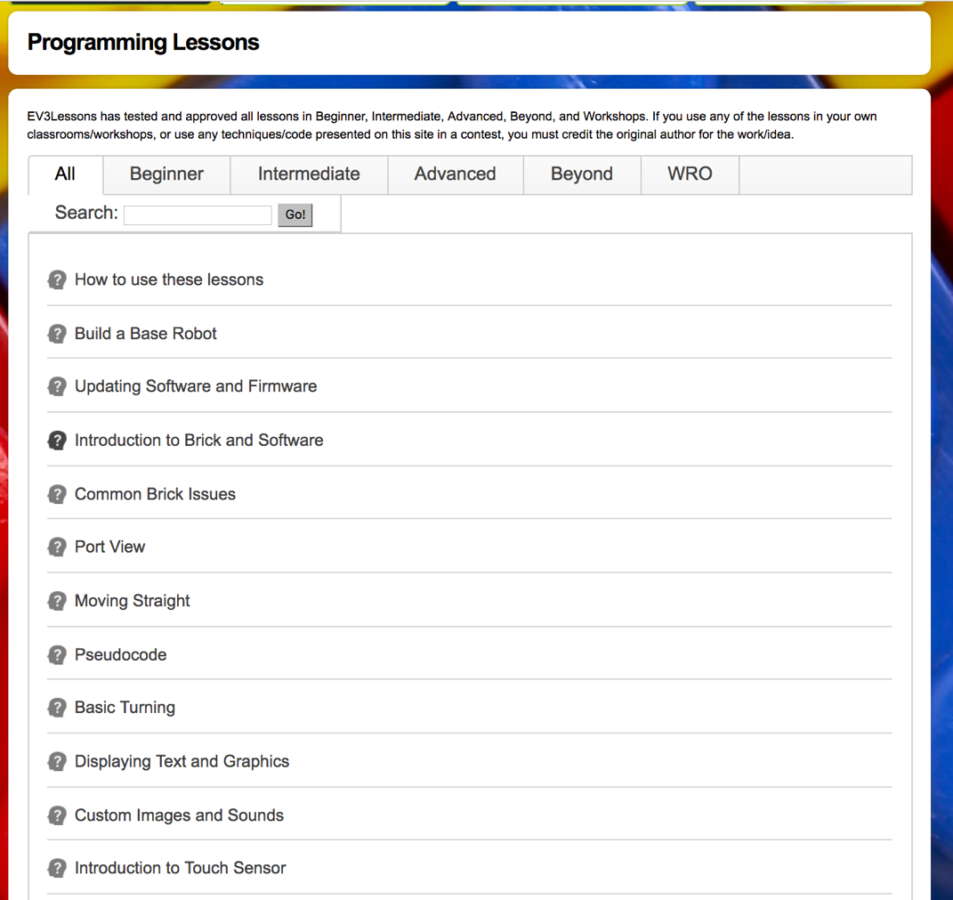
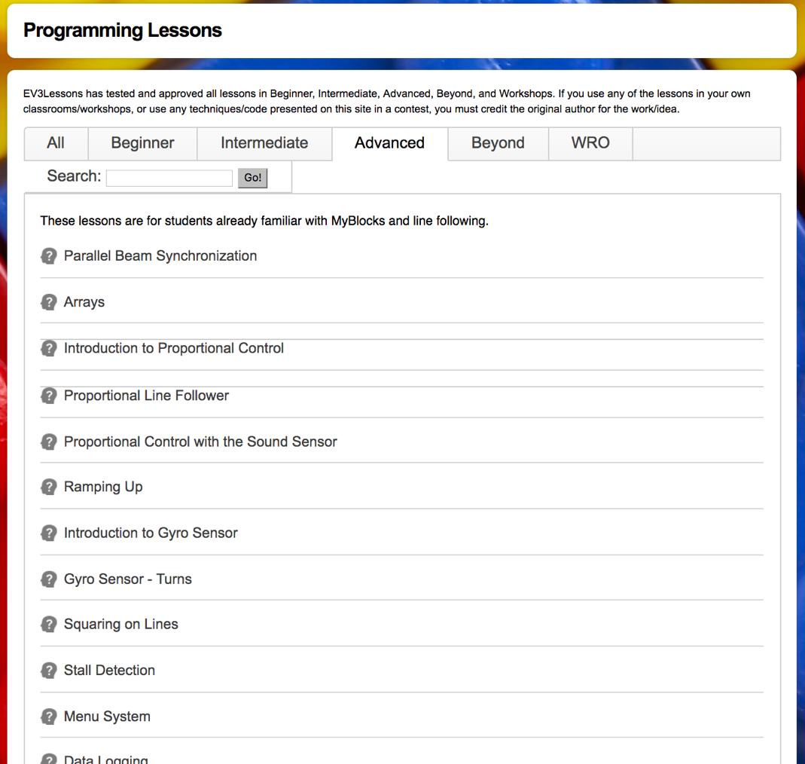
LEARNING TO PROGRAM: EV3LESSONS.com

Slide 24
RECOMMENDED PROGRAMMING CONCEPTS TO LEARN
Beginner Team
Move Until a Color (a line on the mat)
Move Until Touch (wall or mission model)
Move Until Ultrasonic (a mission model)
Loops and Switches
Comments in code
Basic Line Follower
Intermediate Team
Using My Blocks (reusable code blocks)
Align on a Line/Squaring on a Line (increasing reliability)
Parallel Beams
Intermediate-level Line Follower (3-state, proportional)
TODAY:
Moving, Turning, Using Sensors, Loops/Switches, Basic Line Following and My Blocks

Slide 25
MOVING FORWARD & BACK

Slide 26
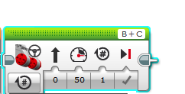
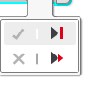
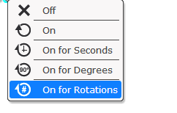
Move STEERING Block
B
C
Mode of operation
Brake/Coast
Steering: Straight or turn
Power/Speed
Duration/Distance

Slide 27
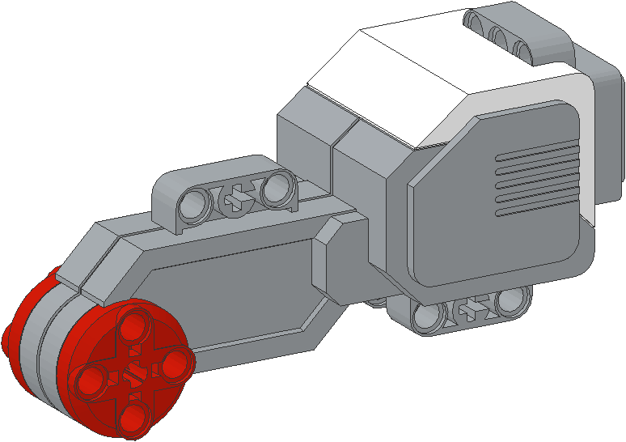
NEGATIVE & POSITIVE POWER: BACKWARD & FORWARD
Negative Power = Backwards
Positive Power = Forward

Slide 28

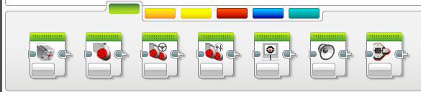
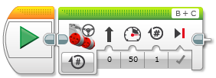
HOW do you Move Straight?
STEP 1: Green Block Tab, Click and hold Move Steering and drag to programming area
STEP 2: Drop next to the Start Block (green arrow)
(See animation)

Slide 29
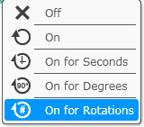
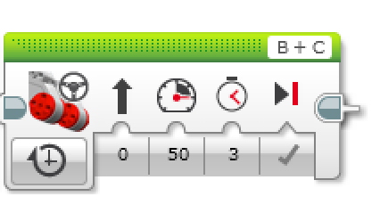
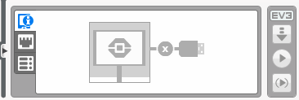
CHALLENGE 1: Move Straight (3 SECONDS)
Step 3
STEP 1: Green Block Tab, Click and hold Move Steering and drag to programming area
STEP 2: Drop next to the Start Block (green arrow)
STEP 3: Select Options. Move “3 Seconds”
STEP 4: Connect USB cable to EV3 and Laptop.
STEP 5: Download to EV3
Step 4
Step 5

Slide 30
Move Straight: Seconds vs. degrees vs. rotations
FINISH
CHALLENGE: Move your robot forward from the start line to the finish line (1) and back to the start (2).
Try mode SECONDS, DEGREES or ROTATIONS and adjust duration/distance
Try different speeds
1
2
B
START
C

Slide 31
MOVE STRAIGHT discussion
Did you guess and check a lot?
Yes. Programming with seconds, rotations and degrees using guess and check takes a lot of time and effort.
Did changing the speed matter?
Yes. When you move in seconds your speed will matter.
Do you think the wheel size will matter? Why?
Wheel size affects degrees/rotations.
Do you this the battery level will matter? Why?
When you move in seconds, battery levels change the power.

Slide 32
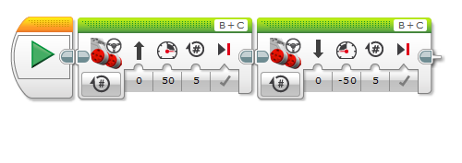
CHALLENGE SOLUTION
This would be changed for degrees or seconds
There is a better way (go to slide 11) to solve this challenge

Slide 33
SOLUTION: USE PORT VIEW
CHALLENGE: Move your robot forward from the start line to the finish line (1) and back to the start (2).
In this lesson, you had to use a lot of guess and check to stop exactly on the second line.
Now try Port View:
Go to one of the rotation sensors (Motor B or C for our robot on the right)
Make sure it is on degrees as the mode and that it starts at 0 degrees.
Move your robot with your hand from the start line to the end line. Make sure that your wheel turns smoothly and doesn’t slip as the robot moves.
Read how many degrees your robot moved
Use this number in the Move Steering Block to move the correct distance.
FINISH
2
1
START
B
C

Slide 34
How do you get to Port View?
Step 1:
Click the Left or Right buttons on the brick until you get to the third tab on the screen (icon with six small circles).
The first choice in this tab is Port View. (Click the middle button on the brick to select Port View)
Step 2:
Use the Left and Right Buttons to pick the port and sensor/motor you want
Left
Right
All images of the EV3 Brick in this lesson were obtained using screenshots of Cogmation’s Virtual Robotics Toolkit.

Slide 35
WHAT YOU SEE in PORT VIEW
A. PORT Number
B. SENSOR/MOTOR & MODE
C. If you select a particular sensor (middle button on brick), you can change the MODE
D. VALUE . You might want to start at “0” (e.g. If trying to measure degrees for a turn). To reset the value, exit Port View and return to back to this screen.
A
B
C
A
B
D
All images of the EV3 Brick in this lesson were obtained using screenshots of Cogmation’s Virtual Robotics Toolkit.

Slide 36
TURNING

Slide 37
PIVOT Vs. SPIN Turns
180 Degree Pivot Turn
Notice where the robot ends in both pictures after a 180 degree turn.
In the Spin Turn, the robot moves a lot less and that makes Spin Turns are great for tight positions. Spin turns tend to be a bit faster but also a little less accurate.
So when you need to make turns, you should decide which turn is best for you!
B
End Position
Motor
B Moves
C
B
Start Position
C
180 Degree Spin Turn
Start Position
End Position
B
B
Motors
B and C Move
C
C

Slide 38
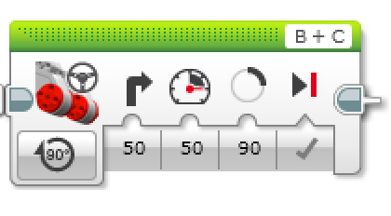
How to Make Pivot and Spin turns
Steering Value
50 | -50 | 100 | -100
Pivot Turn Right | Pivot Turn Left | Spin Turn Right | Spin Turn Left
B
B
B
B
C
C
C
C
Move Steering Block
Change Steering value here

Slide 39
MAKING A Pivot turn for 90 DEGREES
?
B
B
C
C
Program your robot to turn 90 degrees....Does the robot actually turn 90 degrees if you just pick 90 degrees for distance?
Ans. NO! Solution on next page

Slide 40
how do you make the robot turn 90 degrees?
Ans. Try using the port view to measure the turn and then input the correct number of degrees.

Slide 41
TURNING CHALLENGES
Challenge 1
Your robot is a baseball player who has to run to all the bases and go back to home plate.
Can you program your robot to move forward and then turn left?
Use a square box or tape
Challenge 2
Your robot baseball player must run to second base, turn around and come back to first.
Go straight. Turn 180 degrees and return to the same spot.
Second Base
B
B
Start and End position
C
First Base
C

Slide 42
CLASS Discussion GUIDE
Did you try PIVOT and SPIN turns? What did you discover?
Pivot turns were fine for Challenge 1, but for Challenge 2, if we used Pivot turns, we were farther away from the base.
What situations would one work better than the other?
Spin turns are better for tight turns (places where there is not enough space) and you stay closer to your original position.
What is PSEUDOCODE? Why do you think programmers find it useful? (pseudocode is from the worksheet)
Pseudocode allows programmers to write out their code in plain English before you code in a programming language. It lets you plan and think before you sit down to code. It lets you share your ideas with others you are working with in a common language.

Slide 43
CHALLENGE SOLUTIONS
Challenge 1
You probably used a combination of move steering to go straight and do pivot turns to go around the box.
Challenge 2
You probably used a spin turn because it is better for tighter turns and gets you closer to the starting point!
Second Base
B
B
Start and End position
C
First Base
C

Slide 44
ADDING SENSORS: Move Until

Slide 45
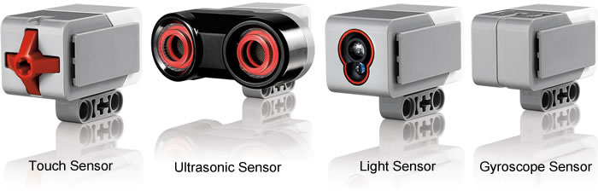
PROGRAMMING: WHY USE SENSORS
Using sensors in FIRST LEGO League is very important (even in your rookie year)
Sensors improve reliability
Sensors can help you know where you are during a run
Touch
Ultrasonic
Color
Gyro

Slide 46
MOVE UNTIL
Move Until is very valuable in FLL:
A black line (color)
A mission model (touch)
A distance (ultrasonic)

Slide 47
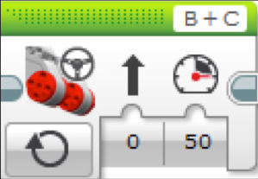
Making The Robot Move
What would happen if you placed a Move Steering Block and left the motor “On”?
Would the robot…
1) Move?
2) Move for a little while?
3) Not move at all?
ANS. Not move at all.
What does Motor Off do?
Rookie Tip: Motor On needs to be followed by another block (e.g. Wait Block)

Slide 48
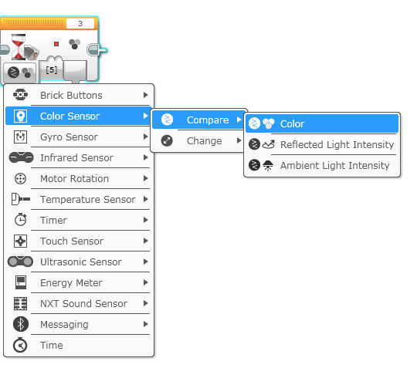
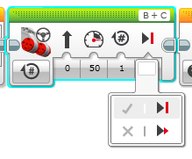
COLOR SENSOR CHALLENGE
Make the robot move up to a black using the color sensor
Step 1: Use Wait For Color
Step 2: Use the color sensor in COLOR MODE
Step 3: Coast or Brake?
Hint: You will use Move Steering (think about motor on and off) and Wait for “Color”

Slide 49
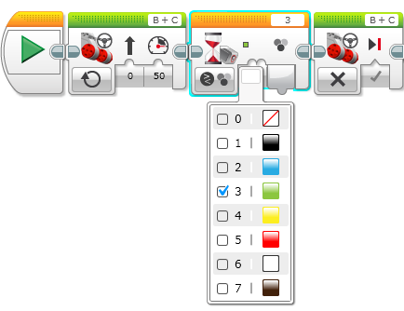
Color Sensor Challenge Solution
FINISH
Move Steering
Set to “ON”
Move Steering
Set to “OFF” with BRAKE
START
Wait until Color is Black (#1)

Slide 50
Loops

Slide 51
Repeating an Action
Let’s say we want the robot to repeat an action over and over again.
Would you just copy the block multiple times?
Sure, that could work!
What if I want to repeat that block forever?
Now what?

Slide 52

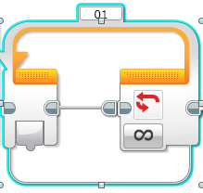
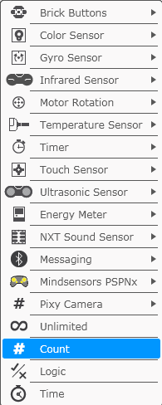
Loops
Loops make repeating a task multiple times easy
The added benefit is that a loop can end whenever you want (a specific number of times, run forever, a specific condition, etc)

Slide 53
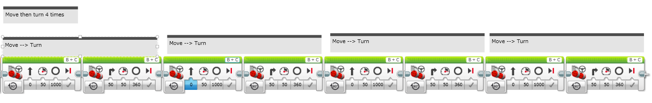
LOOP CHALLENGE
Challenge: Write a program to go around a box once.
The simple way is to code it like this:
Use a loop to improve the code

Slide 54
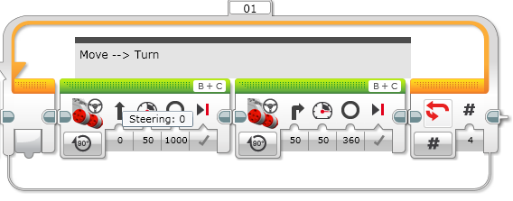
Loop CHALLENGE Solution
Run 4 times

Slide 55
Switches

Slide 56

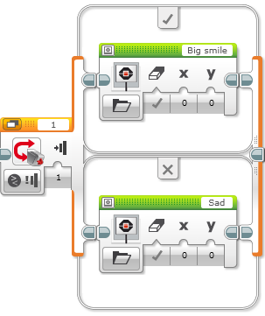
Switch Blocks
Run this code if the answer is yes
Asking the robot a question and doing something different based on the answer
Example: Does the robot see a line? Or not?
Basically a YES/NO QUESTION
Switch blocks are found in the orange/flow tab
The question being asked: is the touch sensor pressed
Run this code if the answer is no

Slide 57

Switch Block CHALLENGE 1
Challenge: Write a program that changes the display based on if the touch sensor is pressed or not pressed.
If pressed, your EV3 is happy! Display a smiley face. If not pressed, the EV3 is sad! Display a sad face.
Hint: You will need to use the display block, loops and switch blocks!

Slide 58
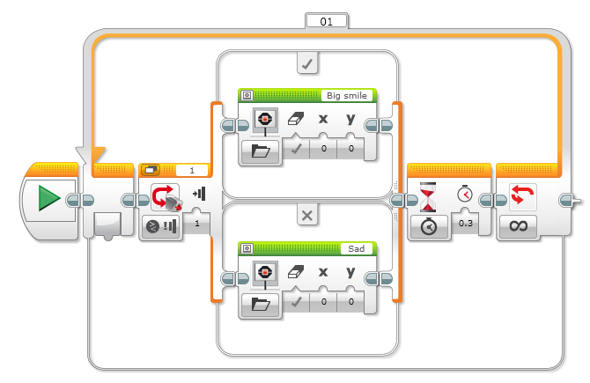
Challenge 1 SOLUTION
Display Block
Touch Sensor
Selected
Wait Block
Loop
Display Block

Slide 59
Switch Block Challenge 2
Can you write a program that display big eyeballs if you touch it once and a sad face if you touch it a second time and toggles back and forth.

Slide 60
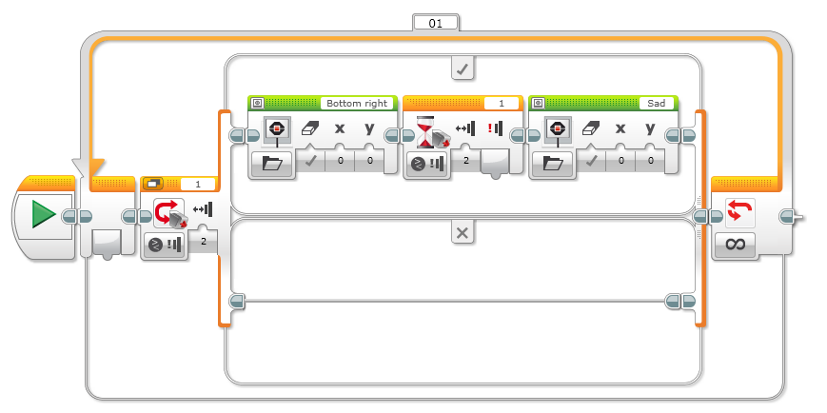
Challenge 2 solution

Slide 61
Basic Line Follower

Slide 62
LESSON OBJECTIVES
Learn how humans and robots follow lines
Learn how to get a robot to follow a line using Color Mode on the EV3 Color Sensor
Learn how to follow a line until a sensor is activated
Learn how to follow a line for a particular distance
Learn how to combine sensors, loops and switches

Slide 63

FOLLOW THE MIDDLE?
Humans want to follow the line in the middle.
Let’s have the robot do the same thing using the Color Sensor
What type of questions can we ask using this sensor
Are you on line or not?

Slide 64
If we are on black, keep going straight
If we are on white, turn left to get back to the line
Seems to work fine here…

Slide 65
If we are on black, keep going straight
If we are on white, turn left to get back to the line
OH NO… my robot is running away….
When the robot leaves the left side of the line, the program no longer works!

Slide 66
Line Following: ROBOT STYLE
Why could the Human follow the middle?:
They can see ahead.
They can see the whole line and its surroundings
They see both sides and which side they left
Why can’t the Robot do the same thing?:
Can’t tell right or left side of the line
How do we make sure the robot always veers off on the SAME SIDE of the line?
Instead of the middle, could the robot follow the “edge”?
So now the robot will fall off only the same side.
We will now show you how this works!

Slide 67
ROBOT LINE FOLLOWING Happens on the edges
Left side line following
Right side line following
If on black, turn left.
If on white turn right.
If on black, turn right.
If on white turn left.
The robot has to choose which way to turn when the color sensor sees a different color.
The answer depends on what side of the line you are following!

Slide 68
starting the roboT on the correct side
✗
✔
✔

Slide 69
Line Follower challenge 1
Step 1: Write a program that follows the RIGHT edge of a line.
Hints: If your sensor sees black, turn right. If your sensor sees white, turn left. Use loops and switches!
Step 2: Try it out on different lines.
Did your line follower work the same on straight and curved lines?
Step 3: If not, instead of turn Steering = 50, try smaller values.
Is it better on the curved lines now?
B
B
C
C

Slide 70
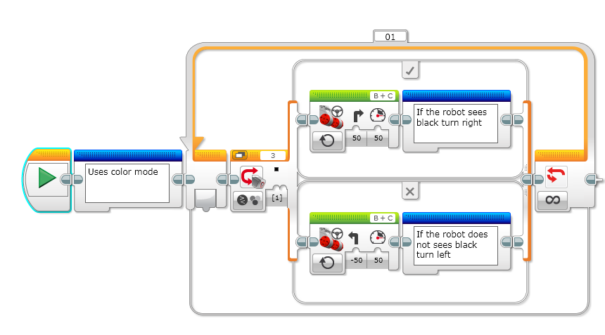
LINE FOLLOWING CHALLENGE SOLUTION
Q. Does this program follow the Right or Left side of a line?
A. The robot is following the Right Side of the line.
Notes:
Right side

Slide 71
CHALLENGE 1 SOLUTION
Q. This line follower goes forever. How do we make this stop?
A. Change the end condition on the loop.
Notes:
Right side

Slide 72
Line follower challenge 2
Part 1: Make a line follower that stops when you press the touch sensor
Part 2: Make a line follower that stops after it travels a particular distance

Slide 73
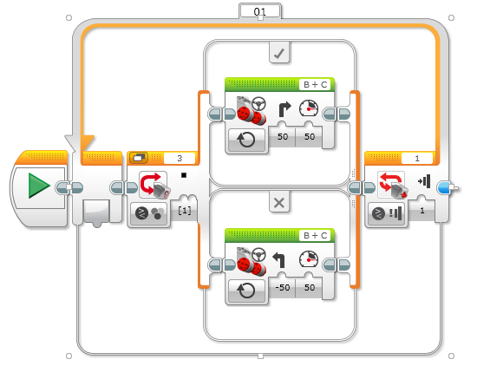
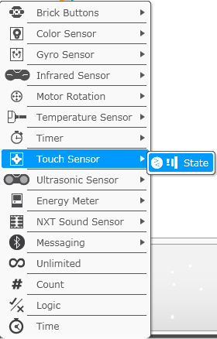
Challenge 2 SOLUTION: SEnsor

Slide 74
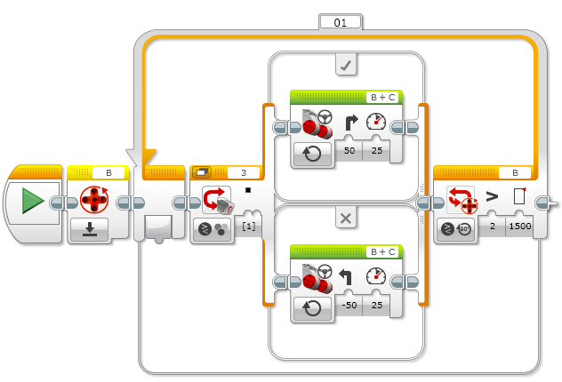
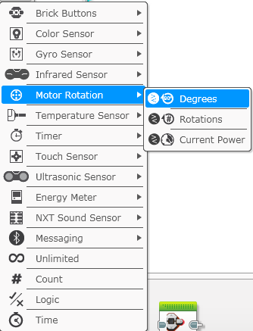
Challenge 2 SOLUTION: PARTICULAR distance

Slide 75
INTERMEDIATE PROGRAMMING LESSON
MOVE Distance My Block (Move_CM)

Slide 76
Lesson Objectives
Create a useful My Block
Learn why creating a My Block that takes measurements made with a ruler can be useful
Make a Move_CM My Block
Prerequisites: Moving Straight, Port View, My Blocks with Inputs and Outputs, Math Blocks, Data Wires

Slide 77
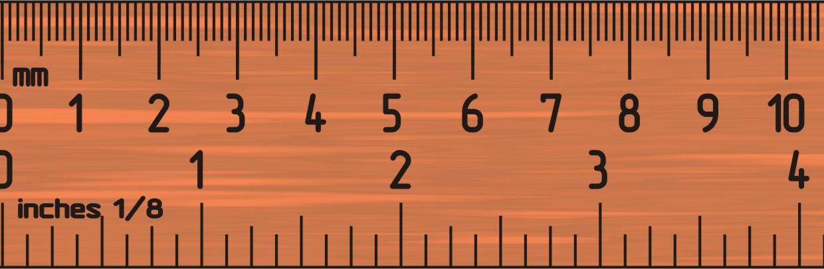
Why a Move Distance My Block?
Built-in move blocks will not take inputs (values) in centimeters or inches.
It is much easier to measure distance with a ruler than degrees or rotations.
If you change your robot design to have bigger or smaller wheels later on, you don’t have to re-measure every movement of your robot
Instead of changing distances in every single program you wrote, just go into your new Move Distance Block and change the value for how many inches/cm one motor rotation would take.

Slide 78
MOVE_CM IN THREE EASY STEPS
STEP 1: Determine how many motor degrees your robot moves in 1cm
STEP 1A: Wheel Measurement
STEP 1B: Program the robot to move 1cm
STEP 2: Add a Math Block to convert centimeters to degrees
STEP 3: Create a Move_CM My Block with 2 inputs (power and degrees)

Slide 79
Step 1A: How Many Degrees Does The Robot Move in 1 CM?
Method 1:
Look up the wheel size in mm printed on your tire and divide by 10 to convert to cm (because 1cm=10mm)
Multiply the answer in step 1 by π (3.1415…) to compute circumference
Divide 360 degrees by value from step 2. This computes degrees in 1cm since you travel one circumference in 1 rotation and 1 rotation is 360 degrees
Example calculation using the standard EV3 Edu 45544 set wheels:
EV3 EDU (45544) wheels are 56mm = 5.6cm in diameter
5.6cm × π = 17.6cm per rotation
360 degrees ÷ 17.6cm = 20.5 motor degrees per cm
Helpful chart with common LEGO wheels and their diameters.
http://wheels.sariel.pl/

Slide 80
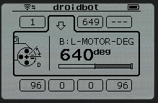
Step 1A: Alternative Method
Alternate Method: Use Port View to find the Motor Degrees value. Use this method if you cannot find the diameter value printed on your wheel.
Put your ruler next to your wheel/robot at 0 centimeters (whatever part of the robot you use to align with 0, you should use to use to measure distance in step 2)
Roll your robot forward any amount of centimeters, making sure your robot does not slip.
Take the degree reading you see on the screen for the motor sensor and divide by the amount of centimeters you moved.
The answer will be the number of degrees your robot's wheels turn in 1 centimeter.

Slide 81
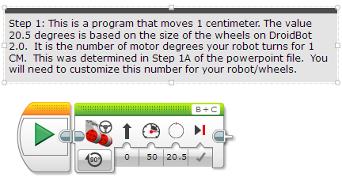
Step 1B: Program Move 1CM
Use the Motor Degrees value you obtained for your robot in slides 5 or 6

Slide 82
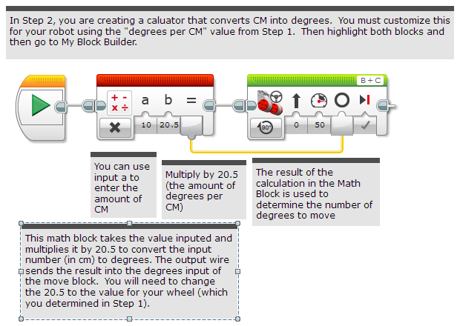
Step 2: Degree to CM Conversion
Create the Calculator that coverts degrees to centimeters

Slide 83
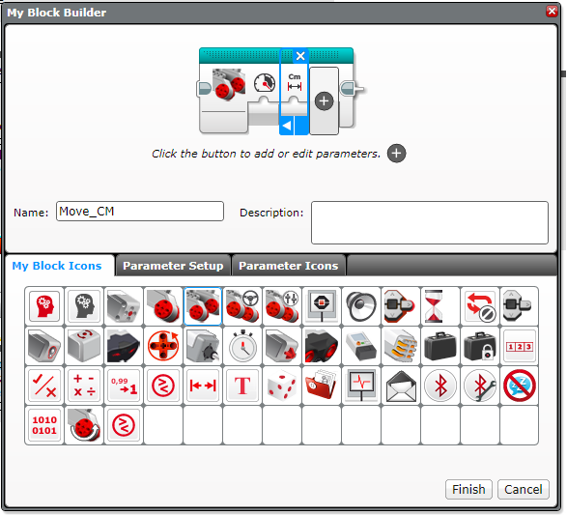
Step 3A: Setup the My Block
A. Highlight the two blocks in Step 2 and go to My Block Builder
B. Add two inputs: Power and Centimeters and complete the setup process.
If you need help in the My Block Builder, refer to the My Block with Inputs and Outputs Lesson in Intermediate
A
B

Slide 84
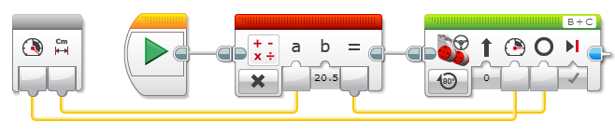
Step 3B: Wire the My BLOCK
C. Wire the inputs in the grey block. The centimeters input connects to the Math Block. The power goes into the Move Steering Block’s power input. The result of the Math Block is wired into the degrees input in the Move Steering Block.

Slide 85
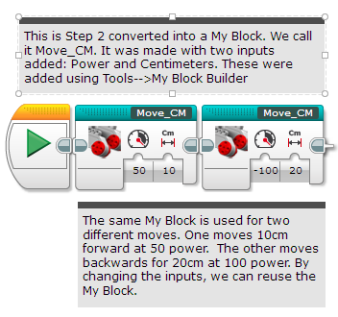
Step 3C: Completed Move_CM

Slide 86
Discussion
Why is a Move_CM My Block useful?
You can measure distances in centimeters and input this number into your block instead of programming in degrees or rotations
Will changing the inputs in one copy of Move_CM impact another copy of it?
No. That is exactly why a My Block is useful. You can use the same block multiple times, each time using a different number for power and centimeters (or any other parameter you set up).
Can you alter a My Block after it is made?
You can change any of the contents, but not the grey blocks (input and output parameters). If you need to make changes to the parameters, you must remake your My Block.

Slide 87
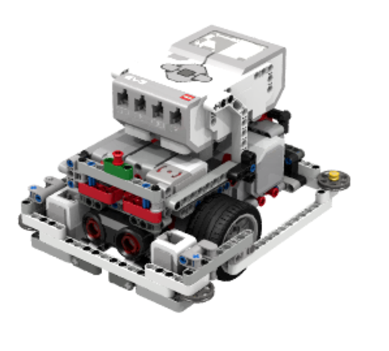
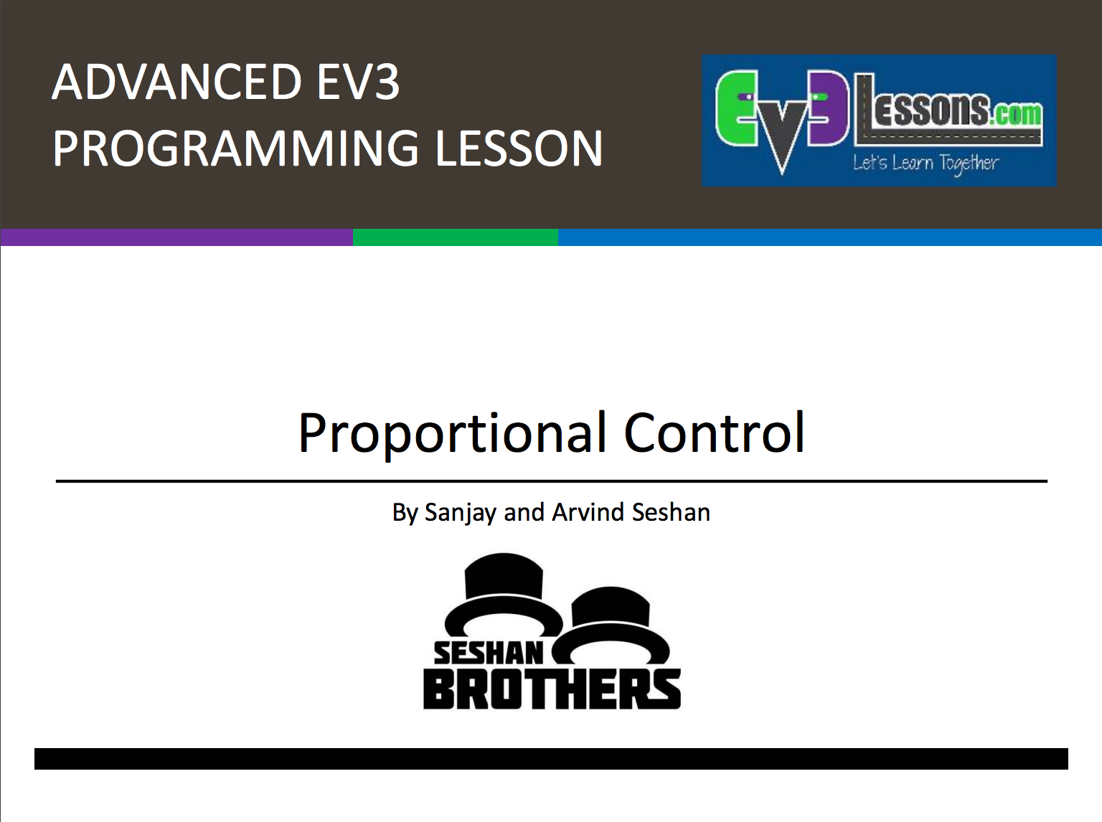






USEFUL LINKS
Over 100 Programming, Robot Design & Research Lessons
Interactive Sketch Planner
Coach’s Corner & Core Value Activities

